Slide 1

Introduction to VBA for Financial Modeling
Thanh Nguyen
Email: thanh.osu@gmail.com

Slide 2
Goal of Today’s class
Provide a brief introduction to programming using Visual Basic (VBA)
Gain some insight to the various benefits of programming
Examine how VBA can be used within financial modeling

Slide 3
A Key Concept for Beginners
A key to programming productivity: “online searches”
Key words searches (i.e., Google):
“IF VBA”
“IF ELSE VBA”
“Breakpoint VBA”
“For Loop VBA”

Slide 4
Key Programming Concepts
Variables
Data Types
Functions & Parameters
If Statements
And/Or Logic
For Loop
Debugging/Immediate window
Comments
How to search

Slide 5
Variables - Common Examples
By definition: Placeholder for any given value
Integer – numbers ( no decimals)
i.e., 6,7,8
Double – numbers (can be decimals)
i.e., 6.5, 7.0, 1.2
Boolean - true or false
i.e., true, false
String - This is represented as text, but can have numbers in it
i.e., “Can you hear me now?”, “What’s up?” “6” “True”
Notes:
May gloss over for now, but will go indepth later

Slide 6
How to set up a variable
Dim Command: Used to define a variable
Examples
Dim Total as Integer
Dim Total as Integer
Dim GreaterThan5Phones as Boolean
Dim GreaterThan5Phones as Boolean
Dim Answer as String
Dim Answer as String
Notes:
May gloss over for now, but will go indepth later

Slide 7
Functions & Parameters
Function: calculates a result based on one or more input values
Function: NPV
Parameters: Information used by function
Parameters: rate, value1, value2
=NPV(rate, value1, [value2], …)
Rate and value1 are required parameters
[value2] is an optional parameter, meaning it isn’t necessary to make the function work
Notes:
Information in cells that you want to do something with. Pass these values as parameters into the functions

Slide 8
IF Statement
An IF statement is a condition that needs to be met in order for something further to happen. In programming, this means a condition has to be true for the following statement to be executed.
Example:
If condition, then something further happens.
If you want this data plan, it’s $10.
If you want to buy this smartphone, it’s $1000.
Notes:
http://support.microsoft.com/kb/170787

Slide 9
Shortcut Key
Keystrokes: Alt-F11
Result: Shows the VBA code

Slide 10
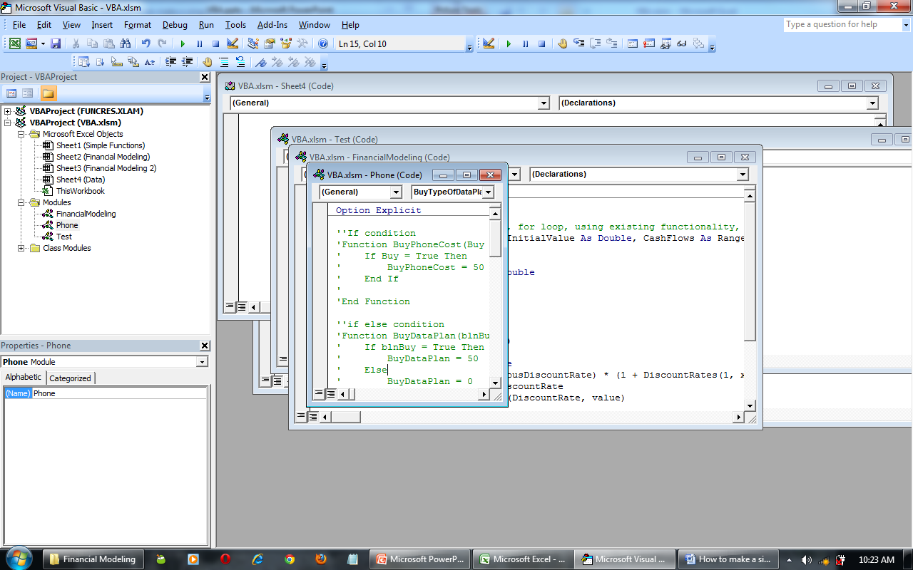
Keystrokes: Alt-F11

Slide 11
Shortcut Keys
Show Parameters: Ctrl-Shift-A

Slide 12
IF ... ELSE
If this condition is met, then do something, else do something else.
Examples:
If you’re thirsty, then go drink else do not go drink .
If you want a smart phone, it’s $60, else, a non-smartphone is $20.

Slide 13
Data Validation
Making model easy for users
Constraining input

Slide 14
Breakpoints
Helps you step through code
Keystrokes
F5: Runs through all of function until next breakpoint
F8: Runs to next line

Slide 15
Immediate Window
Helps you debug/understand results of code
Keystrokes: Ctrl-G

Slide 16
IF … ELSE IF … ELSE
If this condition is met, then do something, else if some other condition is met, then do something else, else do something.
If A, then B, else if C, then D, else E.
Examples:
If it’s 90 degrees, it’s hot, else if its 70 degrees, its nice, else it may be pretty cold.
If you want unlimited text messages, it’s $30, else if you want 1000 text messages, its $20, else, it’s $0.

Slide 17
AND ... OR
This condition AND this condition – both conditions need to be true to continue
This condition OR this condition – as long as one of them is true, continue
The sun is hot and cold – false
The sun is hot or cold – true
If you want a data package or unlimited text, it’s $30.
If you want a data package and unlimited text, it’s $50.

Slide 18
For Loop
Something is going to happen over a predetermined number of times
Examples:
For 2 shoes, I’m going to tie each one.
For 5 days this week, I’m going to go to work.
For 1-2 phones, there is no discount. For 3-4 phones, there is a 10% discount on the 3rd and 4th phone. If you buy 5 or more, there’s a 15% discount on the phones 5 and above.

Slide 19
Questions?
Thanh Nguyen thanh.osu@gmail.com

